Slide 1
AIH Data Filtering Comparison
Amy Lyden

Slide 2
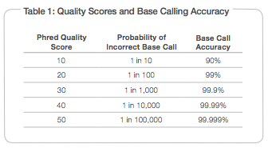
Phred(-like) Quality Scores
Calculating Phred Quality Scores Q scores are defined as a property that is logarithmically related to the base calling error probabilities (P)² .
Q = − 10 log10 P
For example, Q30 → 1:10^3 chance the base was improperly called
Slide by Kalani Ratnasiri

Slide 3
FastQ Files
Slide by Kalani Ratnasiri

Slide 4
PriceSeqFilter
PriceSeqFilter Command:
`PriceSeqFilter -a 12 -rnf 90 -log c -rqf 85 0.98`
a 12: # of threads to use
rnf 90: 90% of the reads must be called. filters our read pairs if either has an unacceptably high number of uncalled nucleotides (N)
log c: determines the type of standard output. c = concise stout (default)
rqf 85 0.98: filters out sequences with an unacceptably high number of low-quality nucleotides, as well as defined by the provided quality scores (only applies to files whose formats include quality score information)
85: the percent of nucleotides in a read that must be high-quality (determined by the .98)
That’s 127.5 bases of a 150bp read
0.98: the minimum allowed probability of a nucleotide being correct (must be between 0 and 1) -- determines quality -- Phred scores of 19.91 and above for a base
Slide by Kalani Ratnasiri

Slide 5
Commands used to process AIH fastqs
PriceSeqFilter
PriceSeqFilter -a 4 -fp {}1_001.fastq {}2_001.fastq -op filt-95-98-90_{}1.fq filt-95-98-90_{}2.fq -pair both -rqf 85 0.98 -rnf 90
Cutadapt
cutadapt -j 16 -a AGATCGGAAGAGCACACGTCTGAACTCCAGTCAC -A AGATCGGAAGAGCGTCGTGTAGGGAAAGAGTGT -o cut-{}1.fq -p cut-{}2.fq {}1.fq {}2.fq -m 36

Slide 6
Summary
 | 1 | 2 | 3 | 4 | 5 | 6
Filtering parameters in PriceSeqFilter | none | 85-98-90 | 85-98-90 | 85-99-9-90 | 95-98-90 | 95-98-90
Cutadapt parameters | none | none | cutadapt, min length 36 | none | none | cutadapt, min length 36
Q score | 0 | 19.91 | 19.91 | 30 | 19.91 | 19.91
Approximate number of reads being kept after PriceSeqFilter | NA | 97% | 97% | 90% | 90% | 90%
Approximate percent of reads kept after cutadapt | NA | NA | 98-99% | NA | NA | 97%
Approximate percent of reads with adaptor | NA | NA | 7-10% | NA | NA | 11-15%

Slide 7
Duplicates removed, comparing case v control only p, DESeq2 analysis
 | 1 | 2 | 3 | 4 | 5 | 6
Filtering parameters in PriceSeqFilter | none | 85-98-90 | 85-98-90 | 85-99-9-90 | 95-98-90 | 95-98-90
Cutadapt parameters | none | none | cutadapt, min length 36 | none | none | cutadapt, min length 36
Number of genes p<0.1 | 2200 | 2208 | 2228 | 2183 | 2192 | 2206
Number of genes padj<0.1 | 16 | 17 | 13 | 17 | 14 | 13

Slide 8
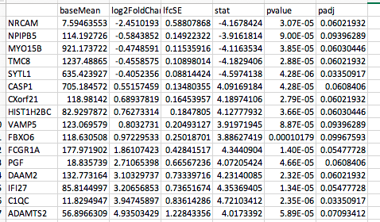
 | 1
Filtering parameters in PriceSeqFilter | none
Cutadapt parameters | none
Q score | 0
Approximate number of reads being kept after PriceSeqFilter | NA
Approximate percent of reads kept after cutadapt | NA
Approximate percent of reads with adaptor | NA

Slide 9
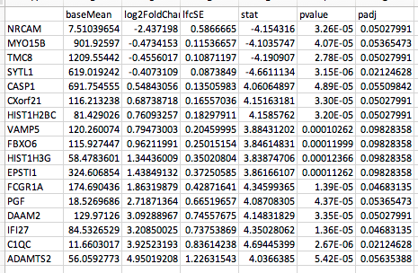
2
85-98-90
none
19.91
97%
NA
NA

Slide 10
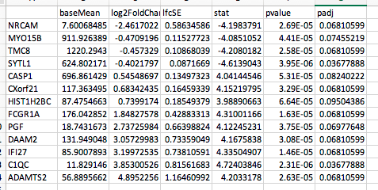
3
85-98-90
cutadapt, min length 36
19.91
97%
98-99%
7-10%

Slide 11
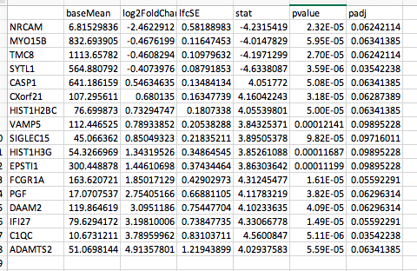
4
85-99-9-90
none
30
90%
NA
NA

Slide 12
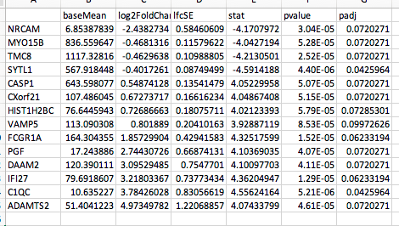
5
95-98-90
none
19.91
90%
NA
NA

Slide 13
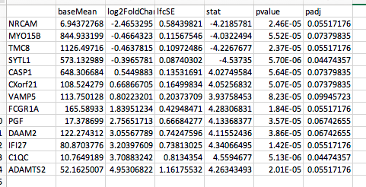
6
95-98-90
cutadapt, min length 36
19.91
90%
97%
11-15%

Slide 14
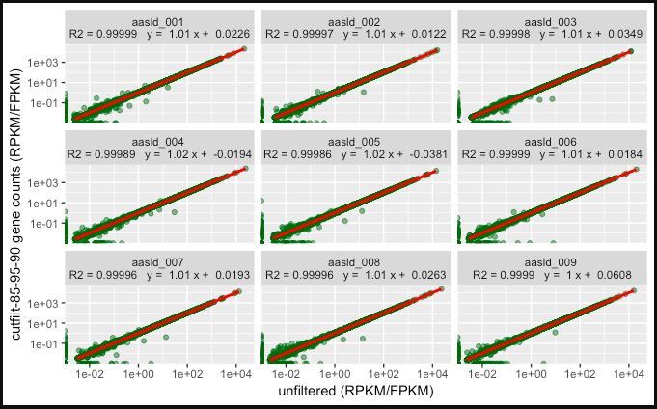

Slide 15
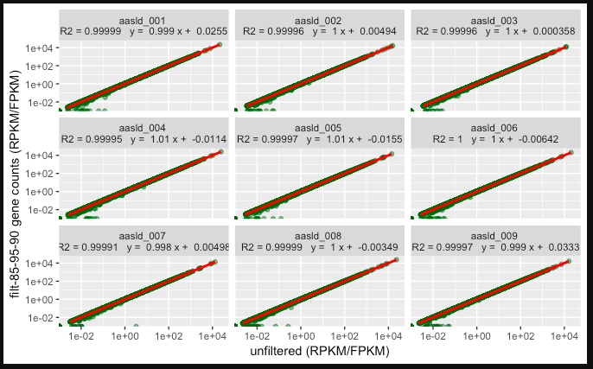

Slide 16
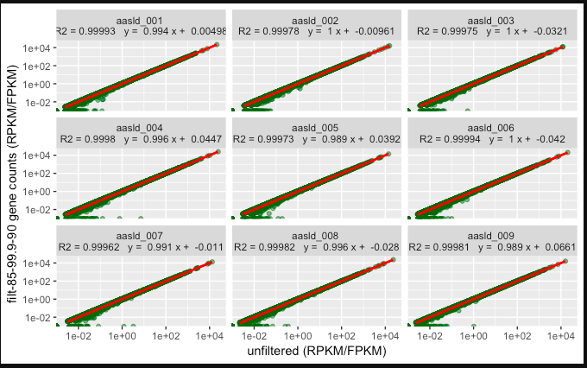

Slide 17
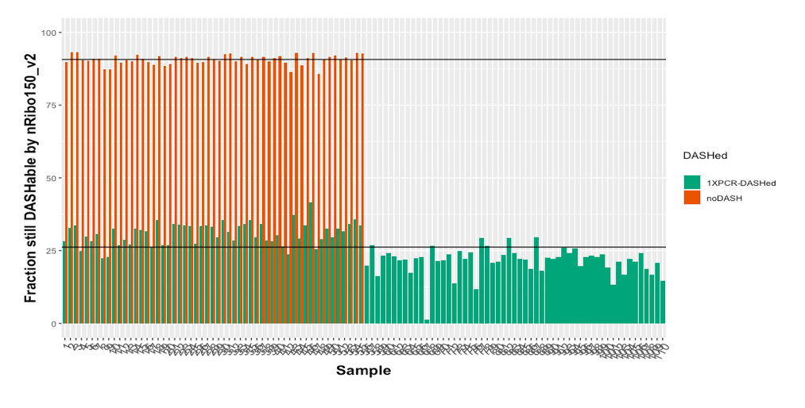
DASH v noDASH nRibo percentage

Slide 18
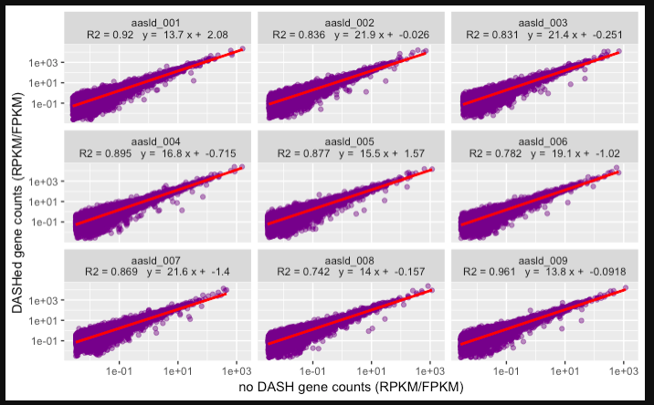
DASH vs no DASH transcripts

Slide 19
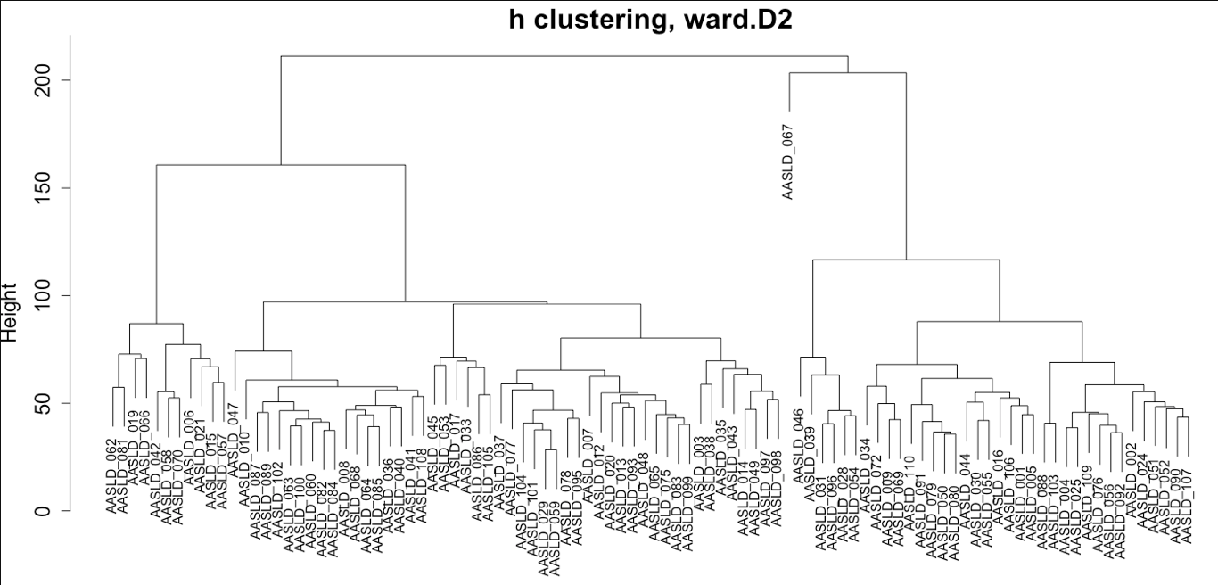
Subsampled 67

Slide 20
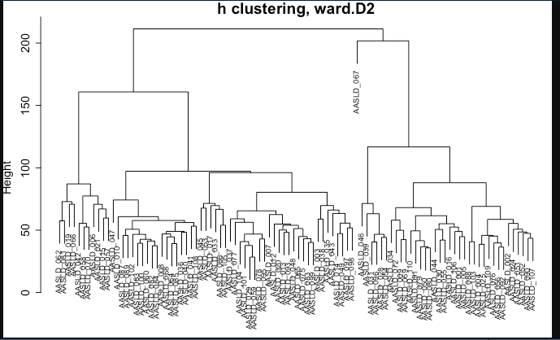
Original 67

